Slide 1


Slide 2
Police Fir Record Management System
Summya Mehveen [2103A51109]

Slide 3
Agenda
Introduction
Objective
Block Diagram
Hard ware & soft ware Requirements
Sample code
Sample Output
Conclusion
References

Slide 4
Introduction
Traditionally, it is a basic process to store the FIR records of the convicts and cases filed.
But it is been a very complex task to maintain the all those records in a book as it consumes a lot of manual work and sometimes the data goes missed.
To overcome this problem, I have come up with my project of Police Fir Record Management System.

Slide 5
Objective
This project is based on a concept to maintain all the Fir records of a police station. From this system, the user can easily add each and every convict’s detail such as convict’s id, name, age, gender, conviction etc. Apart from this, the user can view/check a list of the records, search all the records and also this application is password protected. Only authenticated users can use the application.

Slide 6
FLOW CHART

Slide 7
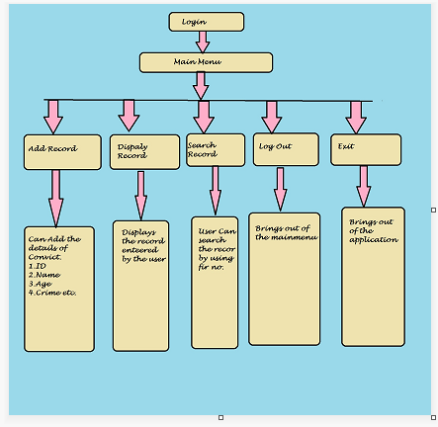

Slide 8
Requirements
Hardware
Device name Mehveen
Processor 11th Gen Intel(R) Core(TM) i5-1155G7 @ 2.50GHz 2.50 GHz
Installed RAM 8.00 GB (7.75 GB usable)
Device ID 93D7640A-04AA-458F-8802-17FAF668D040
Product ID 00356-24535-15794-AAOEM
System type 64-bit operating system, x64-based processor
Pen and touch No pen or touch input is available for this display
Software
Edition Windows 11 Home Single Language
Version 21H2
Installed on ‎22-‎05-‎2022
OS build 22000.1219
Experience Windows Feature Experience Pack 1000.22000.1219.0
Dev C++

Slide 9
Source Code
#include<stdio.h>
#include<conio.h>
#include<string.h>
#include<stdlib.h>
struct record
{
char name[20], gender[7], complaint[50], court[50], details[50],crime[11],date[40];
int age,appointment,id;
struct record *next;
}
struct record *start=NULL;
struct record *addrecord(struct record *start);
struct record *display(struct record *start);
struct record search(struct record *start);
int genereatefir();
void mainmenu();
void check_user(char username[10], char password[10]);
int main();

Slide 10
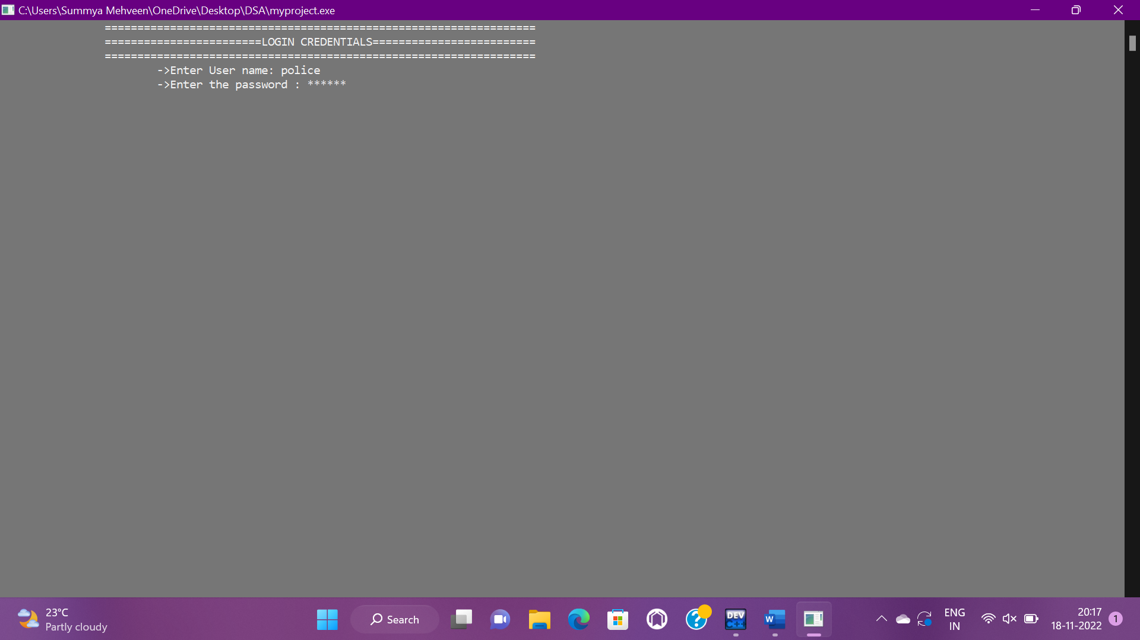
Sample Output

Slide 11
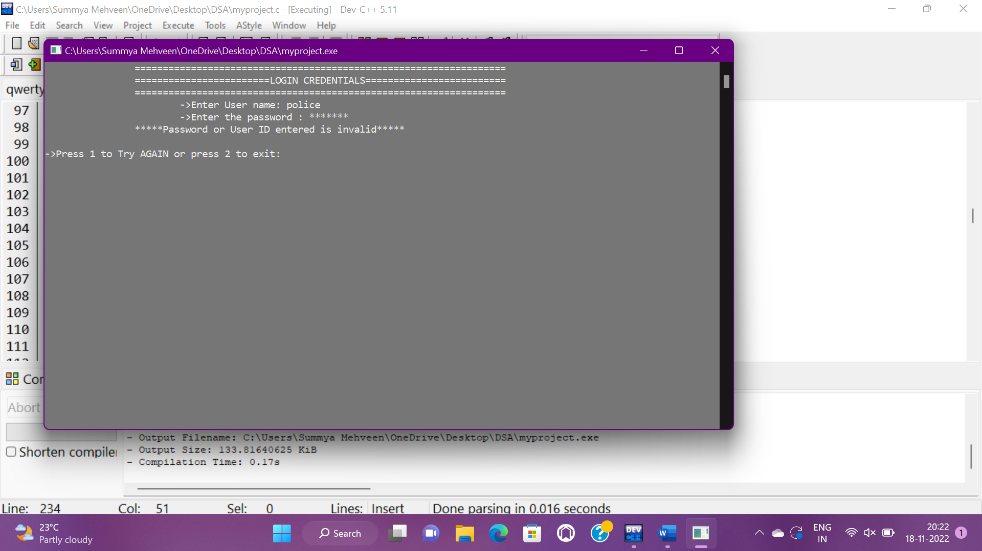

Slide 12
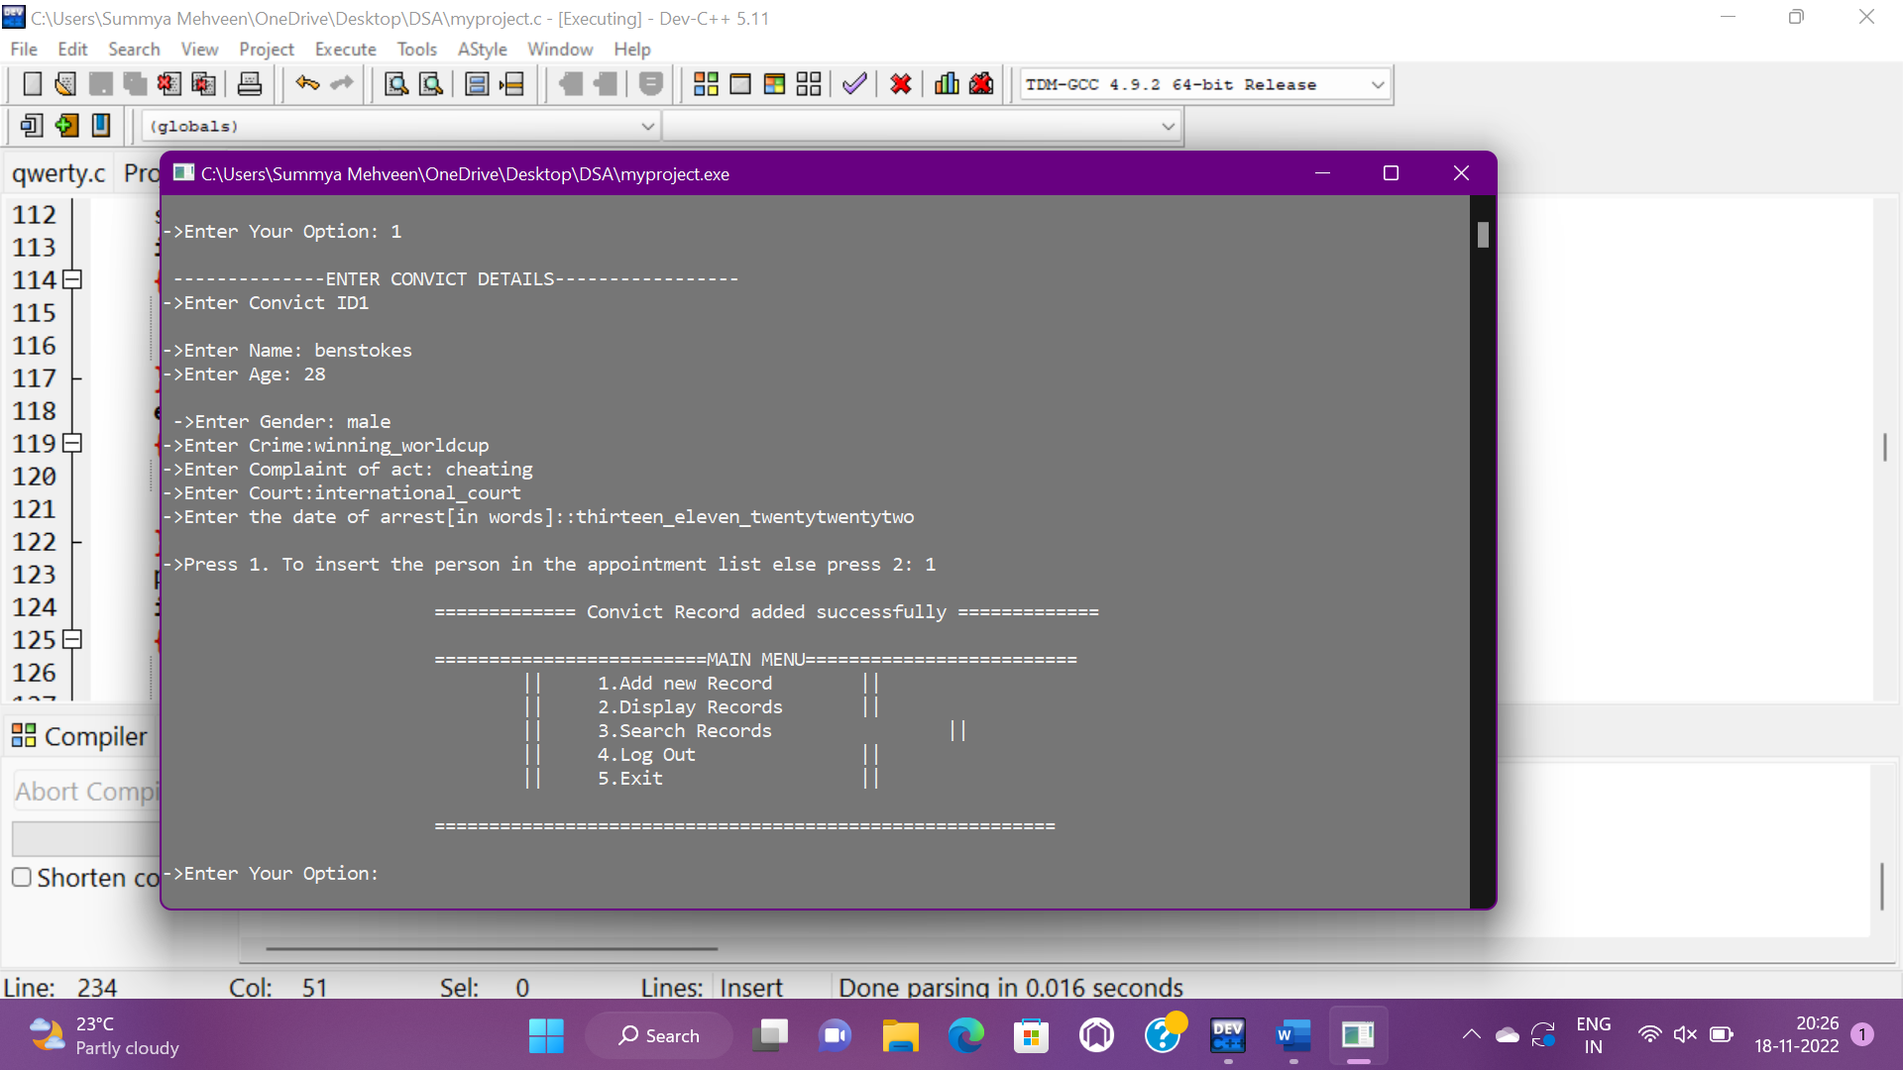

Slide 13
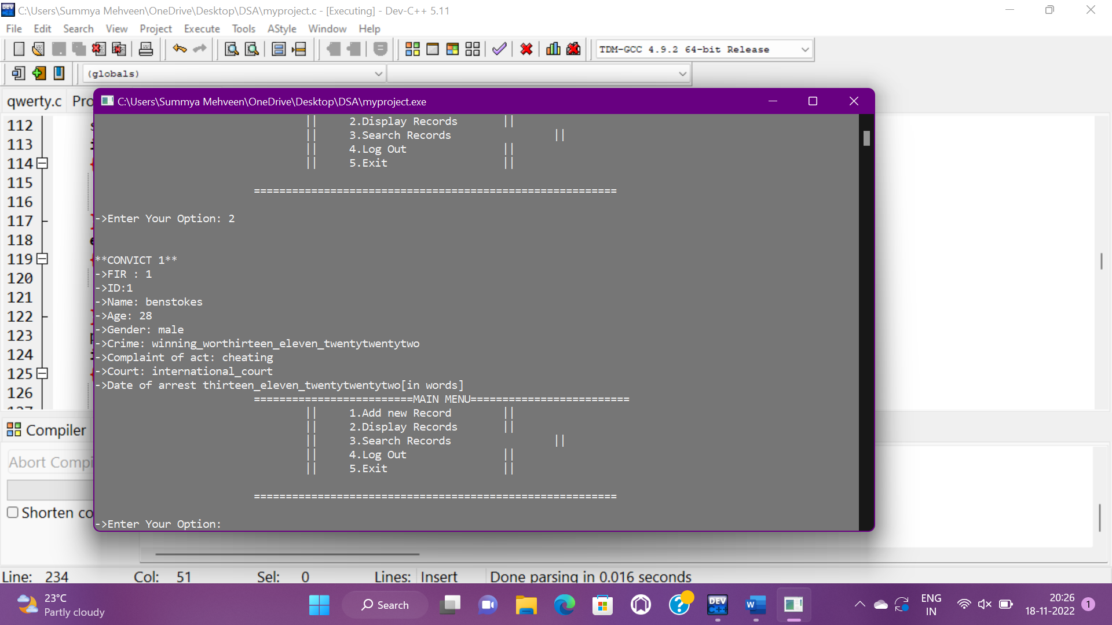





Slide 14
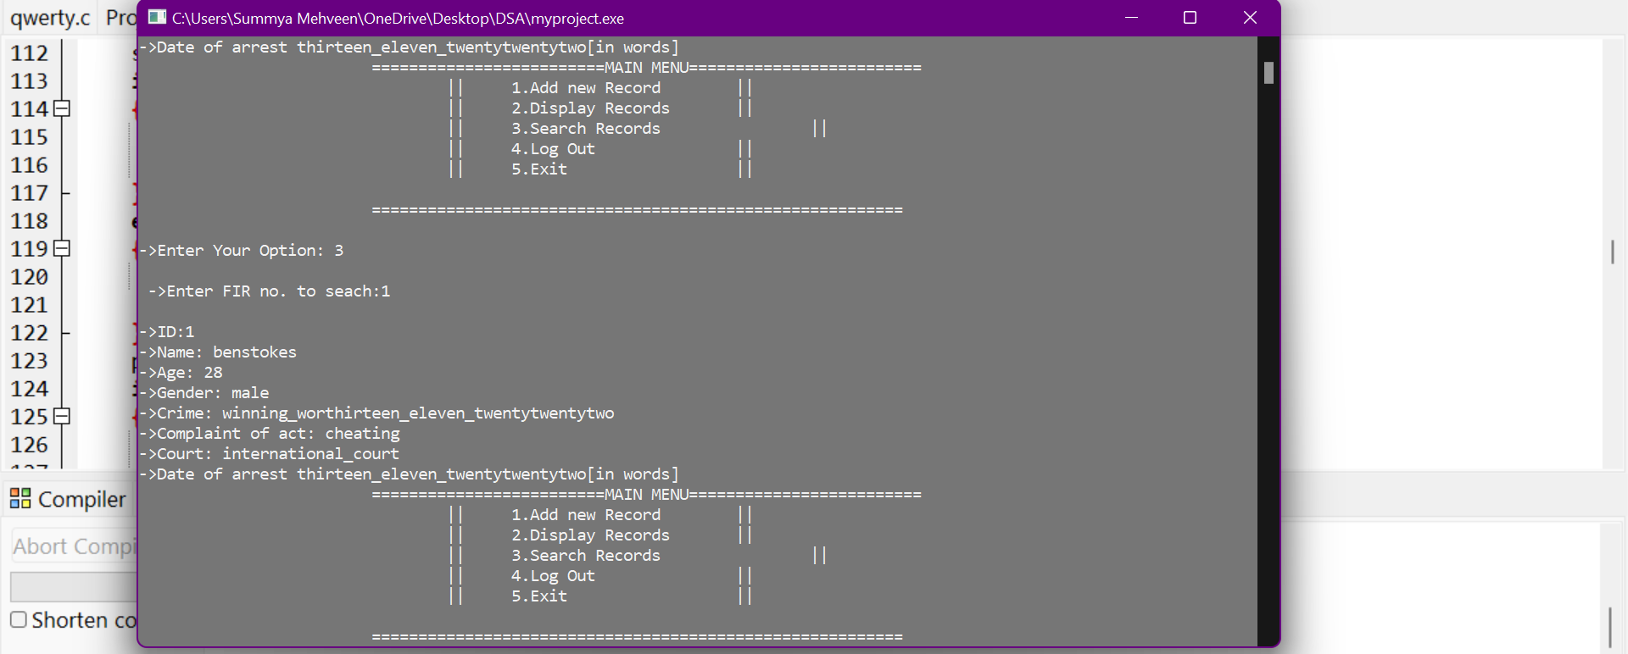

Slide 15
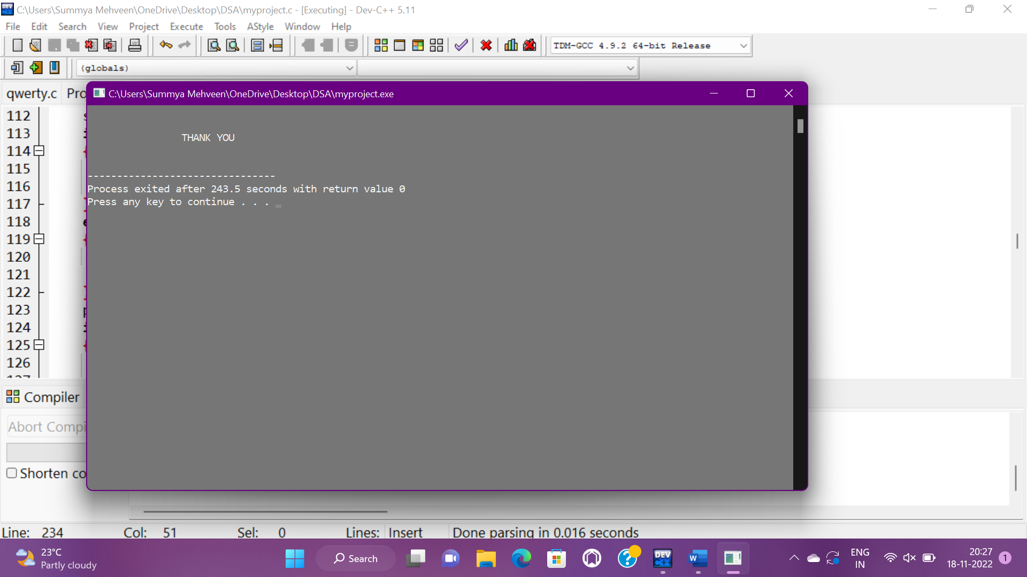

Slide 16
Conclusion
By the project, I can conclude that we can add, delete, store and display the information of the accused FIR’s of a police station.
This project becomes a user friendly application for further purposes in future.

Slide 17
References
https://geeksforgeeks.com/
https://codeorg.com/
Let us C by Yashwanth katnekar
Introduction to datastructures
https://code-projects.org/police-fir-record-management-system-c-programming-source-code/

Slide 18
Thank You!

